Slide 1
Sprint 4 - Presentation
By Justin, Fares, Garrett

Slide 2
Challenges we faced
The biggest challenge we had was getting the robot to perform the sprint accurately more than once. The same program that would make the robot overshoot one time would stop too early the next
Another issue was finding time for all three of us could meet with no issues
We had to use a Mac in order to get the sensor data

Slide 3
Roles of each team member
Justin: Programmed the robot for all sprints
Fares: Organized meetings
Garrett: Worked on System Design Document and problem solved any issues

Slide 4
What we learned about software engineering
Programming fundamentals: We learned and implemented important concepts such as loops in our programs
Block-based coding: We learned simple block coding and got an introduction on how to create programs
Problem solving skills: We had to think creativity to solve any issues that we ran in to
Collaboration and teamwork: We had to work together as a group to schedule meetings and share ideas on how we would approach the work.

Slide 5
What would we do differently
Better Time Management: It would of been a lot less stressful if we completed the sprints earlier
Keeping the robot charged: Made it more difficult to use the robot since the battery was always so low
Accessibility issues: Since one person had the robot it is the responsibility of that person to give the robot to any other group members that wish to use it
Planned meetings: We would often have to reschedule meetings because the classroom was already being occupied. We would fix this by checking the room is available before the meeting.

Slide 6
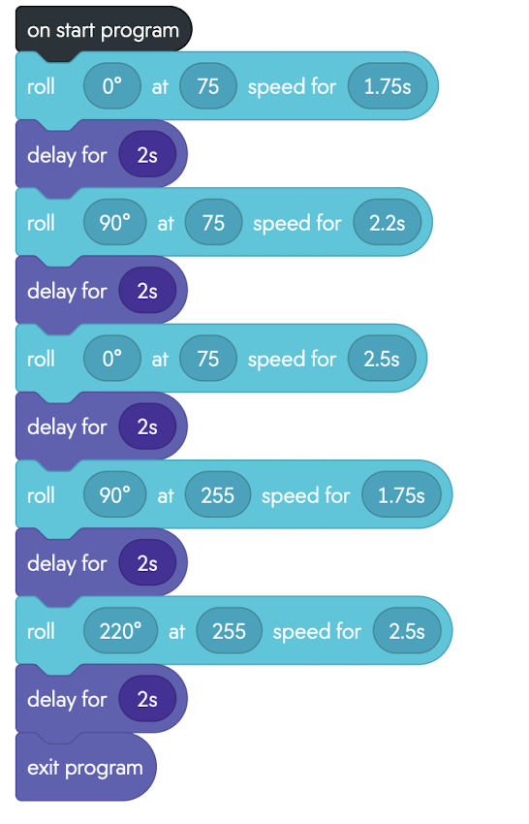
Block Code for Sprint 3 Agility

Slide 7
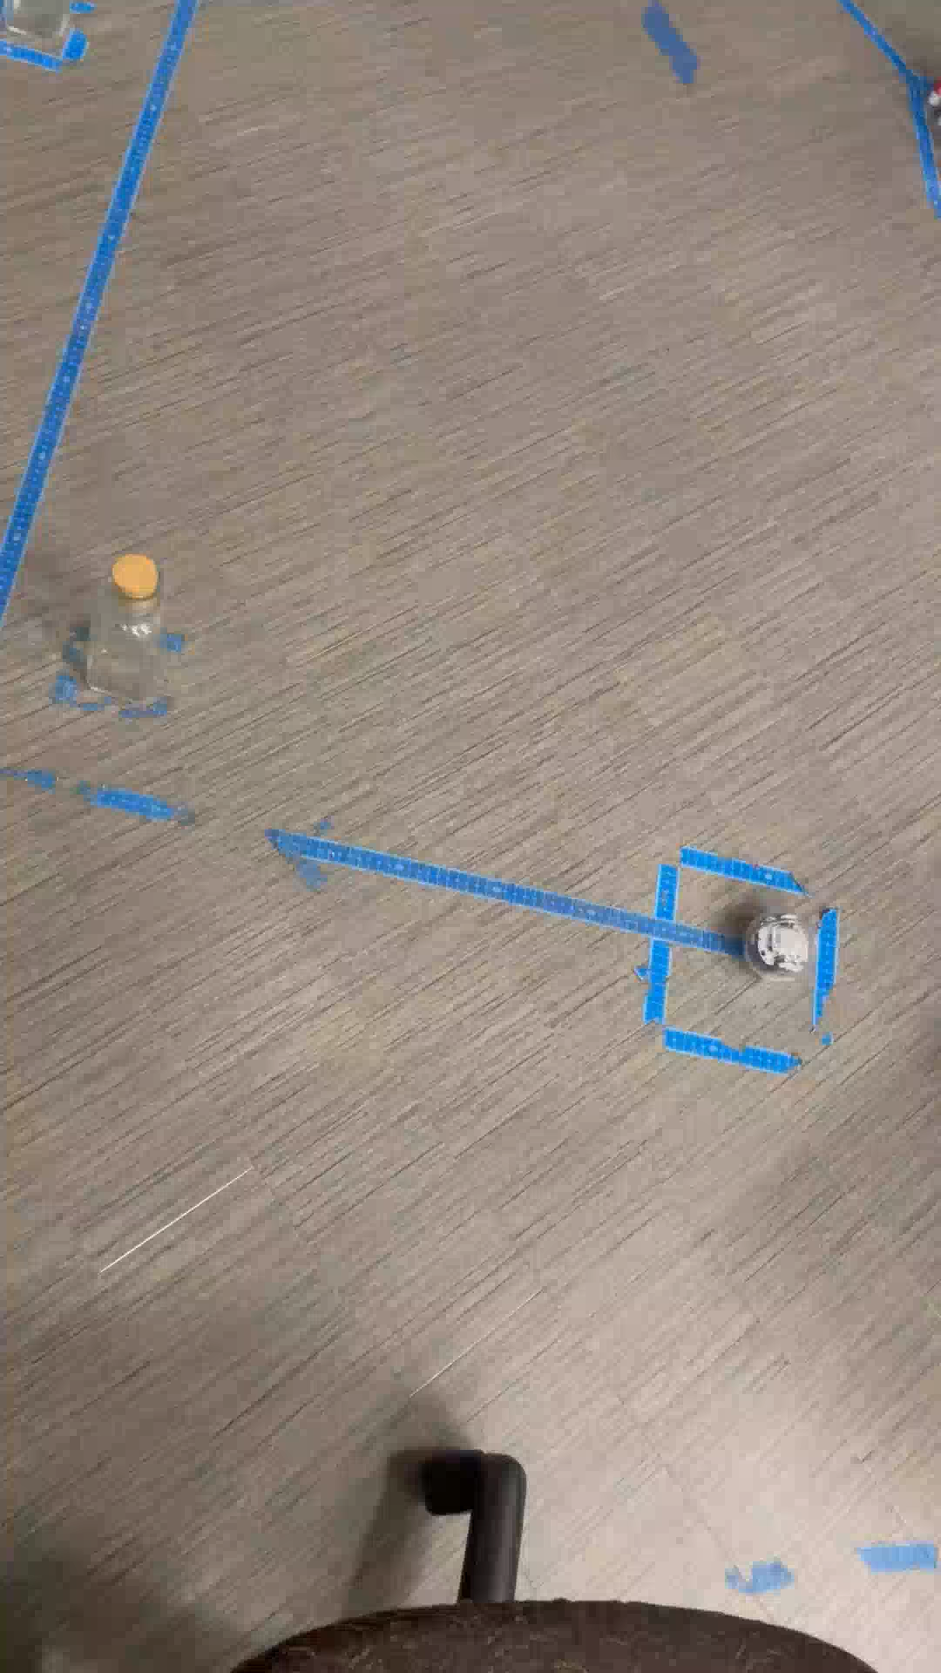
Video of robot doing the Agility sprint

